Slide 1
New Features - Day3
Customer Attraction and Advertisement
SQL sheets for Govt. record and Data Analytics
SMS facility based on Red Dot Algorithm
Emergency Features Added
UI of Mobile app and Website are updated

Slide 2
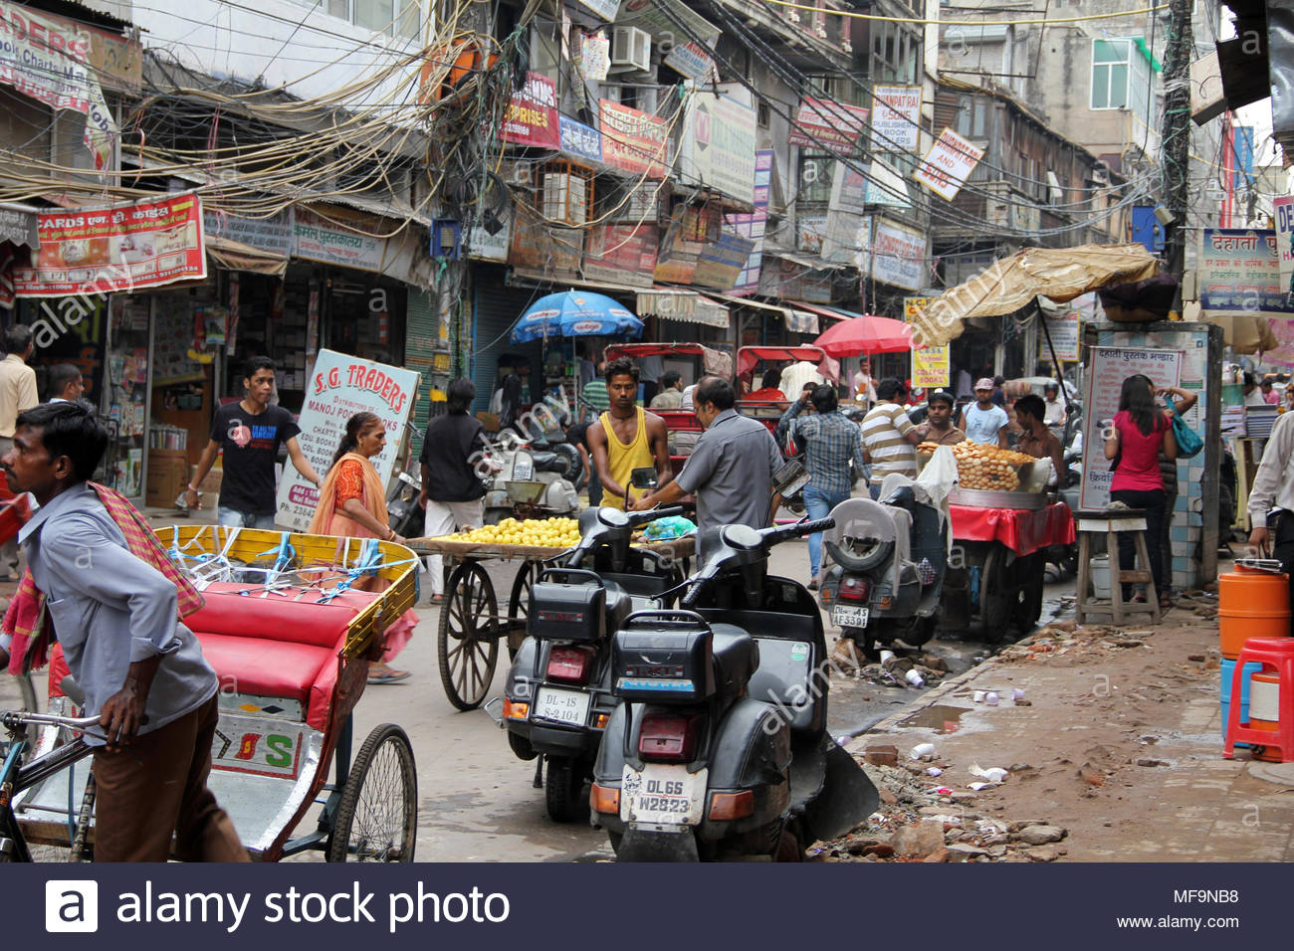
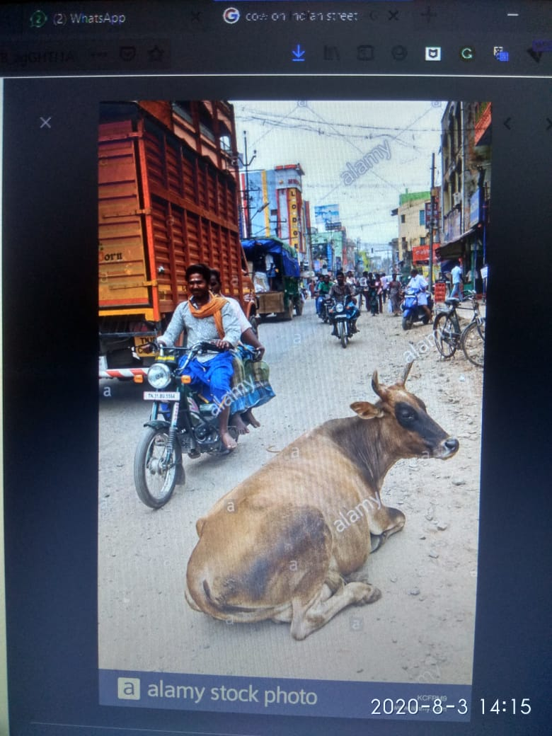
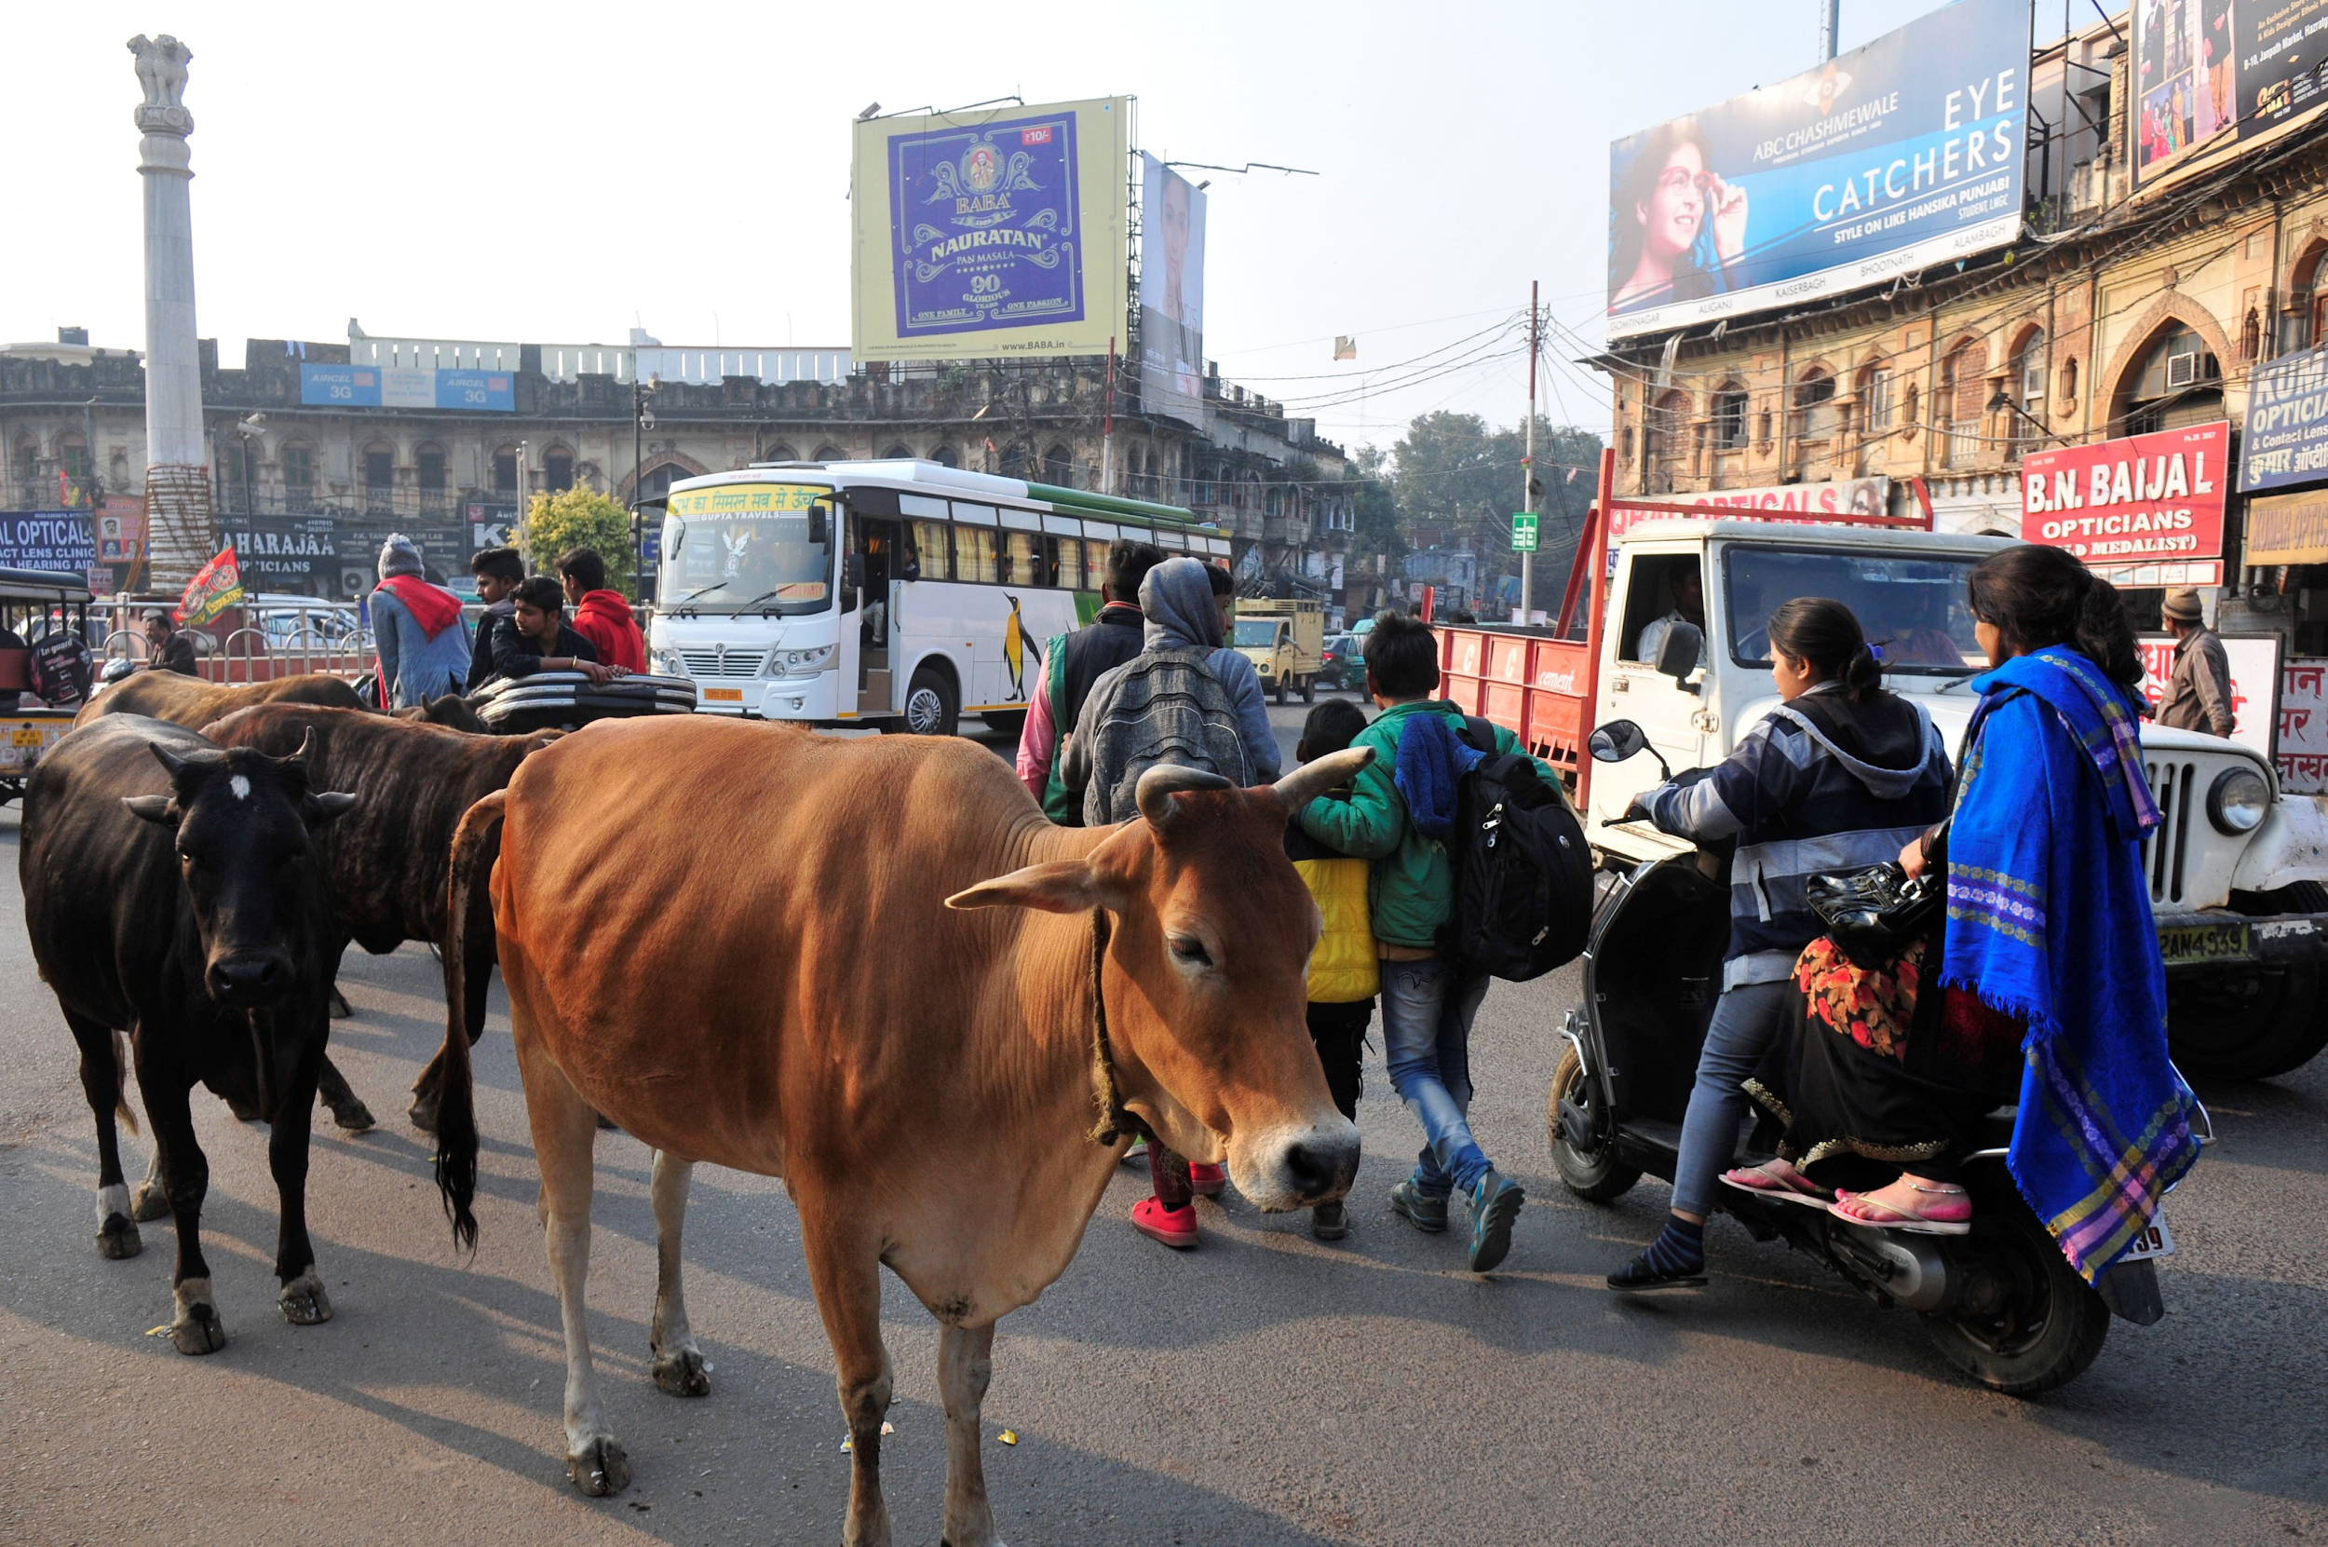
Junk and Resource Management- Aghnya
Only if the Model Confidence for an animal in image is greater than threshold (70%), the image is stored, put in database, and processed further
If a user continuously, puts up false images. He/she can be banned after warnings
After Model, A physical Layer is also kept, to remove other false images, that may appear true to model
As, data increase, the mentioned step, can be completely automated
FALSE IMAGE filtered by Model
FALSE IMAGE detected true by model and filtered physically
True Image stored, and resolved

Slide 3
Junk and Resource Management- Aghnya
We take full responsibility of our Software solution, Special care has been taken, while developing solutions like mobile app, Website, SMS etc for our end-users. Our users, don’t have to worry about, Resource management, Project Scaling, Deploying, Networking etc. After Discussing the Revenue yesterday, let’s discuss effective needs p.m.
Images (Complaints) p.m. (App+CCTV) | Total Storage (2mb/img) {Considering all Complaints actually had animals} | Effective storage {Considering all Complaints were accepted} - deleting accepted images every week after resolving | Others (Temp files, Text Data etc) Creation
1000 p.m. (avg. 250 img/week) | 2GB | 0.5GB | 2mb+ few Kb’s of text data and SQL
10,000 p.m (avg. 2500 img/week) | 20GB | 5GB | 2mb+ few Kb’s of text data and SQL
1,00,000 p.m (avg. 250 img/week) | 200 | 50GB | 2mb+ few Mb’s of text data and SQL

Slide 4
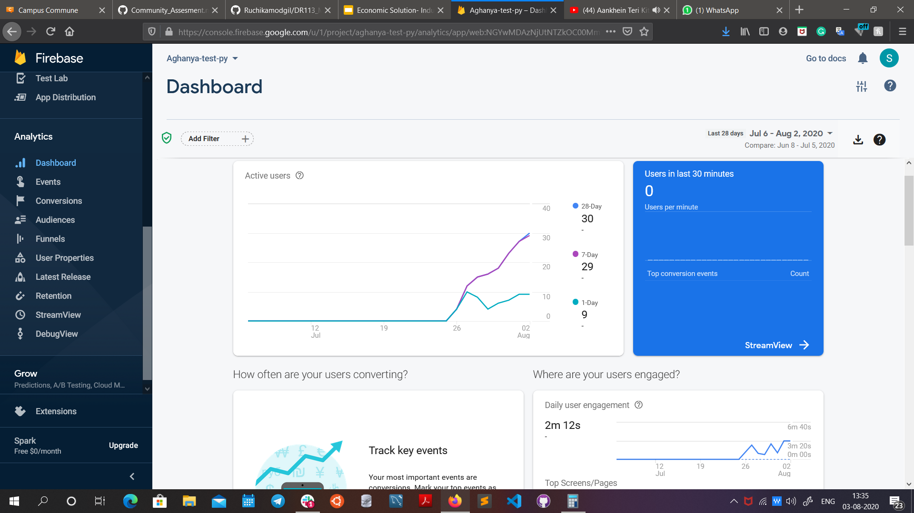
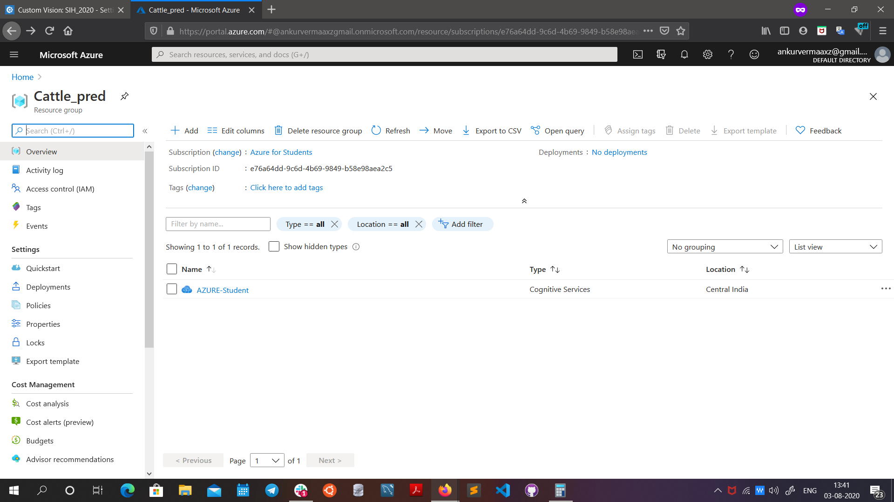
Junk and Resource Management- Aghnya
Resources like Storage, VM’s, Prediction Key Network, Database, are all managed by companies like Microsoft and Google
These resources are auto-scalable, based on the average requirements, thus saving a lot of money
They also provide services like Crash Analytics, Performance, Revenue, Usage, etc
Triggers, for over-usage, over-revenue, over-api calls, over-storage can also be implemented.

Slide 5
Junk and Resource Management- Aghnya
Similarly, if NIC Data centers are used, Such analysis can be done manually and triggers for up and down scaling can be set
Local Area Connection, also reduces network lag, if any
Models deployed in Data centers are free from any lag/crash activity

Slide 6
Long Term Sustainable Model- Aghnya
Targets Government, NGO’s, Ministries as probable Consumers
GOI, State Government, Ministries, NGO’s, PETA, people for Animals, Volunteers etc. are stakeholders in a way or other
Revenue is generated from Consumers, Google Ads can also be used for this purpose
Our model included all possible costs and margins, and is very sustainable in that manner
Long term partnerships (With cloud providers, Government etc.) are even better, saving a lot of money, and adding a lot of new benefits.
As Aghnya grows, it can be expanded in Dimension of Wildlife, Security etc. and can be integrated with IoT nodes

Slide 7
Aghnya in next 5 years
Starting from Goa, Aghnya app can be implemented in the entire country
As India is advancing towards Digital India and More and More data is being generated, Data Centers of Government bodies like NIC are opening up pan India
Aghnya can be expanded to Ministries like Forestry, Wildlife etc.
Aghnya can be retrained to detect various other animals, that need attention like Dogs, Monkeys, Elephants, Blue Bull (Nilgai) etc.
With more and more Users and Data, and with the expansion of project, We would be able to prepare much more precise models, so precise, that they can no only detect normal animals, but can detect animals in danger/ emergency, Classify Animals by their breed.
With data, we can also predict the possibility of finding a particular animal on a particular day at some location

Slide 8
Aghnya as a Career option
If given a chance by GOI, We would like to pursue Aghnya as a Career option, we would love to work more on betterment of Aghnya Project, while keeping in mind the Cost, Benefits for Employees and Partners and Health of Animals.
In Partnership with GOI, State Government, Ministries, NGO’s, PETA, people for Animals, Volunteers etc. Innocent Animals can be saved from undeserved treatment. All the above mentioned are potential stakeholder in Aghnya in a form or other
As we grow, we would try to solve the following problems too:-
Wildlife:- Keep an eye on Endangered and other vital species with 0 Human Interaction
Forestry:- Keep an eye on Poaching, Wrong hunting practices etc
Military:- Efforts to reduce illegal Smuggling of Animals across borders
Agriculture:- Keep an Eye on Animals near large fields, that can be a danger for crops
Accident Prevention:- Predicting the probability of presence of an animal on road

Slide 9
